Slide 1
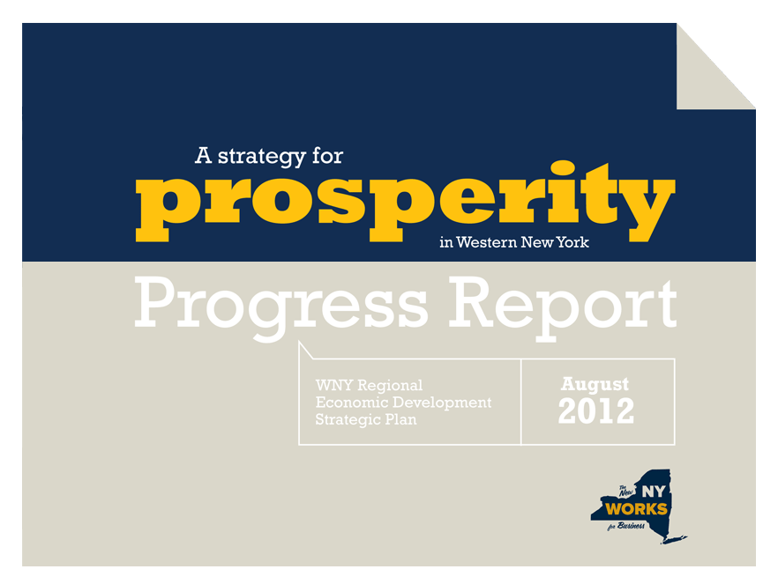
A presentation to New York State Governor Andrew Cuomo

Slide 2
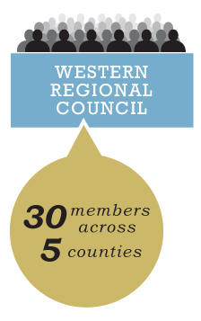
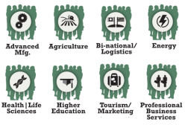
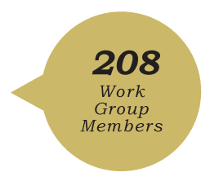
A Collaborative Community Driven Process
2,000+
People involved
Regional Council
Public Meetings
Stakeholder Forums
Community Presentations
Interviews
Industry Sector Work Groups
Notes:
Howard

Slide 3
2011-12 Projects
Project Dashboard
96
Projects
received
93%
$100.3
Projects moving forward
Million
1%
Projects delayed or on hold
Grantee declined award
6%
Notes:
Howard

Slide 4
Measuring Our Progress
Underrepresented groups
in the workforce
Graduation rates
Wages
Jobs
Firms
Visitors
Brownfields remediated
Acres of protected natural resources
Business start-ups
Venture capital funds

Slide 5
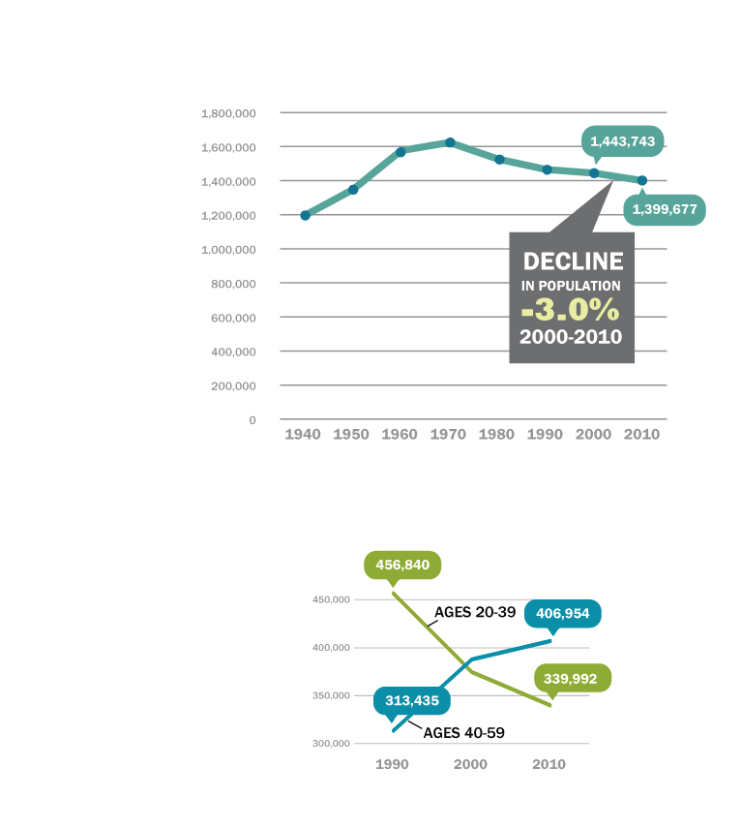
The five-county WNY region is the only one in NYS to decline over the past 10 years.
Our Region’s Population
Informing Our Criteria
and Strategy
WNY is losing its young people and not attracting enough new people.

Slide 6
Our Criteria
Making Smart Decisions
Creates/Retains/Fills Jobs
Essential for all projects
Maximizes Return on Investment
Ready for Implementation
Inclusive
Promotes Smart Growth
Oriented to Young Adults
Builds upon Strengths
Regional Impact
Improves Region’s Image
Notes:
Howard

Slide 7
Three Primary Themes
Making Smart Decisions
Notes:
Howard
TRANSITION TO WORKFORCE DEVELOPMENT… INTRODUCE CLOTILDE

Slide 8
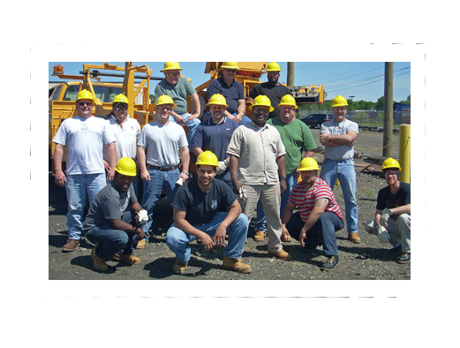
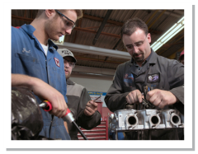
MYTH:
No Jobs in WNY
REALITY:
Disconnect between workforce and jobs market
VS
In manufacturing production, 50% of the workers are 50 or older. 75% of all other workers are under 50. Manufacturing workers will be retiring twice as fast as all other workers.
Notes:
Clotilde
The National Talent Dividend statistics rank the Buffalo/Niag MSA 39 of 50 in terms of college degrees
Slide 8- Myth vs. Reality (30 seconds)
Point of the Slide: With this slide, we want to get the point across that the issue isn’t the availability of jobs, rather it’s connecting the right people to the right jobs that is our challenge
Talking Points
-The National Talent Dividend statistics rank the Buffalo Niagara MSA 39th out of 50 in terms of college degrees
-How will we do this?

Slide 9
Buffalo has an abundance of unemployed people with high school level of education attainment
50%
of unemployed workers
have a HS degree or less
Notes:
Clotilde
Buffalo’s black male jobless rate is 51%, ranked highest among the top 35 largest American cities.
Slide 9- Abundance of unemployed people (30 seconds)
Point of the Slide: Buffalo’s unemployment rate
Talking Points
-Buffalo’s black male jobless rate is 51%, ranked highest among the top 35 largest American cities

Slide 10
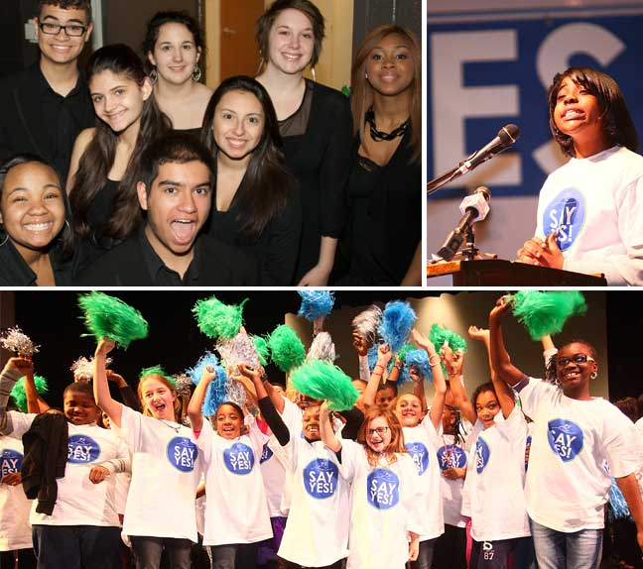
Say YES Buffalo
VIDEO HERE
Notes:
Clotilde
Slide 10- Say Yes (2 minutes and 15 seconds)
Point of the Slide: Say Yes
Talking Points- I am sure you have talking points on this that are much better than what I might have
-Quick overview of Say Yes (15 seconds)
-Two minute video
(Clotilde, there is a chance we may use the video on the tour bus. As soon as I know, I will let you know. If we end up using the video on the tour bus, we will just need you to fill that time with more dialogue about Say Yes. Probably about one minute altogether.)

Slide 11
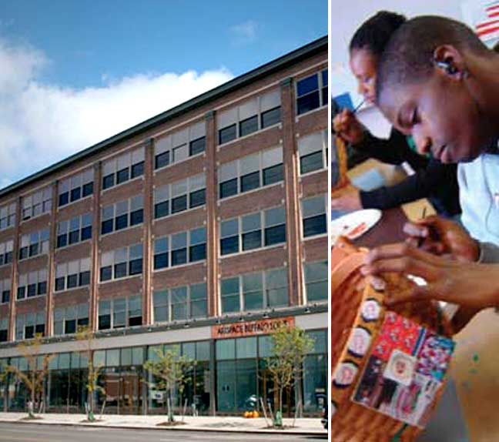
2011 FUNDED PROJECTS
Buffalo Arts and Technology Center (BATC)
Will provide training to up to 200 unemployed and underemployed adults and assist them in reentering the workforce
Arts & Technology program to serve 400 at-risk students
Dream It, Do It
National initiative to promote careers in advanced manufacturing
Notes:
Clotilde
Slide 11- 2011 Projects (45 seconds)
Point of the Slide: Brief overview of our 2011 CFA funded projects
Talking Points
-Two other tremendous projects that will help solve Buffalo’s workforce issue are the Buffalo Arts and Technology Center and Dream It, Do It.
-The BATC will serve two purposes: to train unemployed and underemployed adults, as well as serve at-risk students, providing them with the skills needed to help them graduate from high school
-BATC is modeled after the Manchester Bidwell Corporation, which is based in Pittsburgh and has been extremely successful in its efforts in working with both adults and children in need
-Dream it, Do It, the national initiative to promote advanced manufacturing careers, was developed by the Manufacturing Institute in Washington, D.C. due to many factories throughout the country reporting a shortage of skilled workforce
-The program has already found success in certain parts of WNY, as DIDI was launched in Chautauqua County in 2009, and in Cattaraugus and Allegany Counties in 2011
-With the addition of DIDI in Erie and Niagara Counties, the formation of DIDI WNY will help serve all five counties in the region

Slide 12
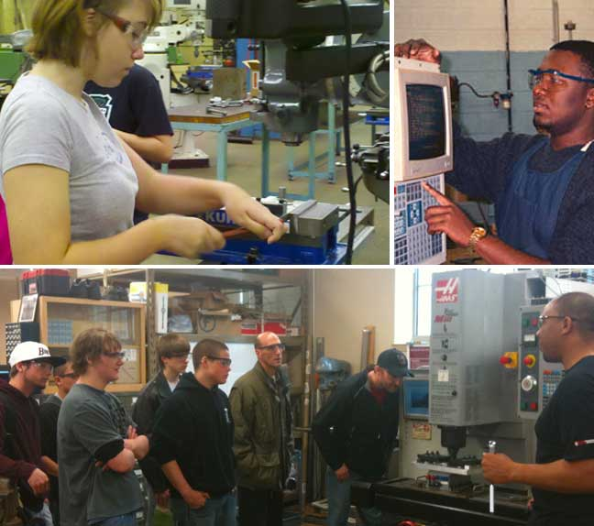
2012 PROPOSED PROJECTS
Finishing Trades Institute of Western & Central New York
Operates 4 NYS approved apprenticeship programs
Represents 1,500 members, more than 100 contractors in 33 counties
Notes:
Clotilde
Slide 12- 2012 Project (45 seconds)
Point of the Slide: Quick summary of our lone 2012 CFA project
Talking Points
-The Finishing Trades Institute is a project recommended by our regional council that will aid our local workforce development efforts
-The FTI’s plans to expand their current facility in Western New York would provide the opportunity for a larger number of local residents to be trained
TRANSITION TO ENTREPRENEURSHIP
-As Howard mentioned previously, there are three key themes in the council’s strategy. With our strong focus on workforce development, entrepreneurship is a natural partner to that. That being said, I’d like to welcome Jeff Belt up to talk about entrepreneurship

Slide 13
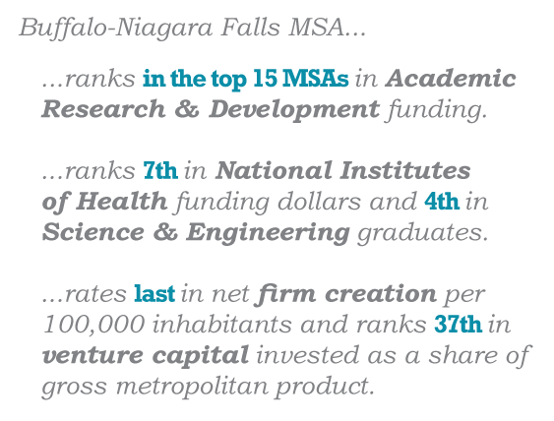
Despite high spending on academic research, we’ve seen little spin-off in the form of new business formation.
Notes:
Jeff

Slide 14
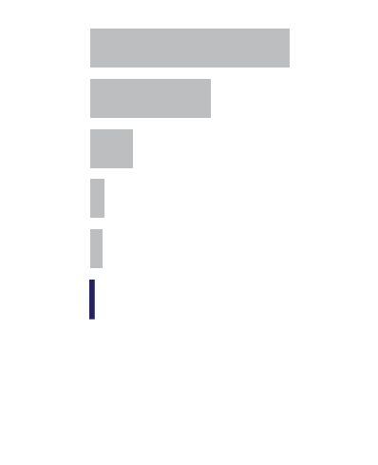
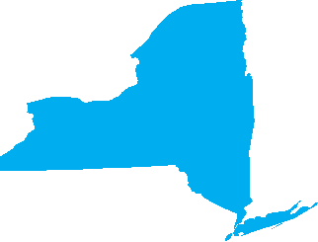
A relatively low level of patent output compared to other places in state and elsewhere
National Patents, 2007-10
RANK (of 374)
San Jose
40,446
#1
NYC area
24,616
#2
Philadelphia
8,795
#14
Poughkeepsie
3,101
#24
Albany
2,841
#28
Buffalo Niagara
1,049
#87
Notes:
Jeff

Slide 15
2011 FUNDED PROJECTS
Launch NY
Venture development organization preparing small companies for outside investment across 26 counties
Received $637,000 in Federal EDA money, with matching grants from Wendt & Oishei
Modeled after JumpStart Inc in Cleveland.
JumpStart’s outcomes:
$495 million raised for client & portfolio companies
1,500 jobs created with $220 million economic benefit
Notes:
Jeff
Modeled after Innovation Works in Pittsburgh
Modeled after JumpStart in Cleveland
$495 million raise for their client & portfolio companies
1,500 Jobs created with $220 economic benefit
How do you build an Entrepreneurial Ecosystem?
Launch received $637,000 in Federal EDA money, with matching grants from Wendt & Oishei
National search for a CEO successful
Support and Invest in High Growth Companies
Venture Development Organization
Preparing small companies for outside investment
Across 26 counties

Slide 16
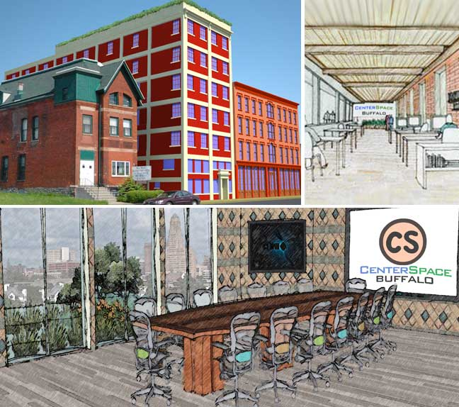
2012 PROPOSED PROJECTS
Center SPACE Buffalo
Multi-tenant office facility
Providing back office services, office management and administration
Modeled on Center for Social Innovation in Toronto- now has 325 groups in 55,000 sq.ft. & 800 employees
Notes:
Jeff
Modeled on the Center for Social Innovation
In Toronto
Started with 13 Groups in 5,000 sf.
Now has 325 Groups in 55,000 sf and 800 employees
Place for small companies, non-profits, unincorporated groups to co-locate
Small groups get to keep their identity while providing certain corporate efficiencies
Pooling intellectual capital in one location
Multiple groups can bid on work and grants together
Focus on new grads who are not yet rooted in the community by providing a low barrier to get started
TRANSITION TO SMART GROWTH… INTRODUCE AARON BARTLEY

Slide 17
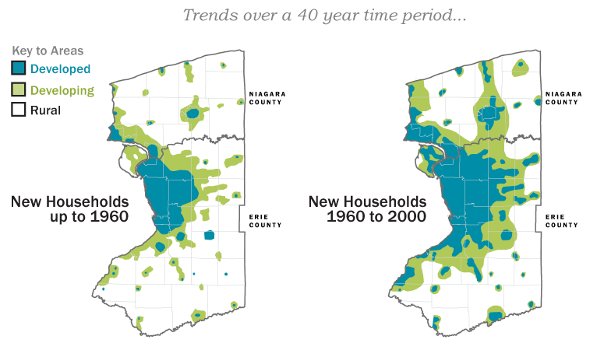
History of Developed Areas up to 1960 and up to 2000
Even as the population declined, the region has been sprawling in a way that burdens taxpayers.
Notes:
Aaron
Smart Growth is a key enabler for fostering economic growth and vitality in Western New York. Over the last four decades, the region’s population has sprawled to encompass almost three times as much land area, while the number of people living in the region declined steadily. The result is a cost burden associated with roads, sewers and other infrastructure that taxpayers can no longer afford. Sprawl has also created concentrated districts of abandoned buildings and poverty in parts of our cities, towns and inner-ring suburbs.
Early on in the planning process, the WNY REDC recognized the necessity of embedding Smart Growth principles in our planning process. In our plan, we adopted an approach to Smart Growth that centers on investment in Central Business Districts, Town and Village Main Streets, and core neighborhoods. Our plan also emphasized the needs to accelerate brownfield development, improve access to our waterways and promoting energy sustainability.
By embedding these core Smart Growth objectives in all of our decision-making, the Council has promoted projects that have already begun to create more vital and equitable communities throughout our region. The Council has favored projects that correspond with Smart Growth principles in our biggest cities—Buffalo and Niagara falls—, mid-sized communities like Olean as well as smaller towns and villages like Springville, elicottville and Wellsville.
Through our Smart Growth work group, the Council has become a crucial forum for coordinating planning across all five counties and aligning regional council priorities with other sustainability planning processes sponsored by HUD and NYSERDA.

Slide 18
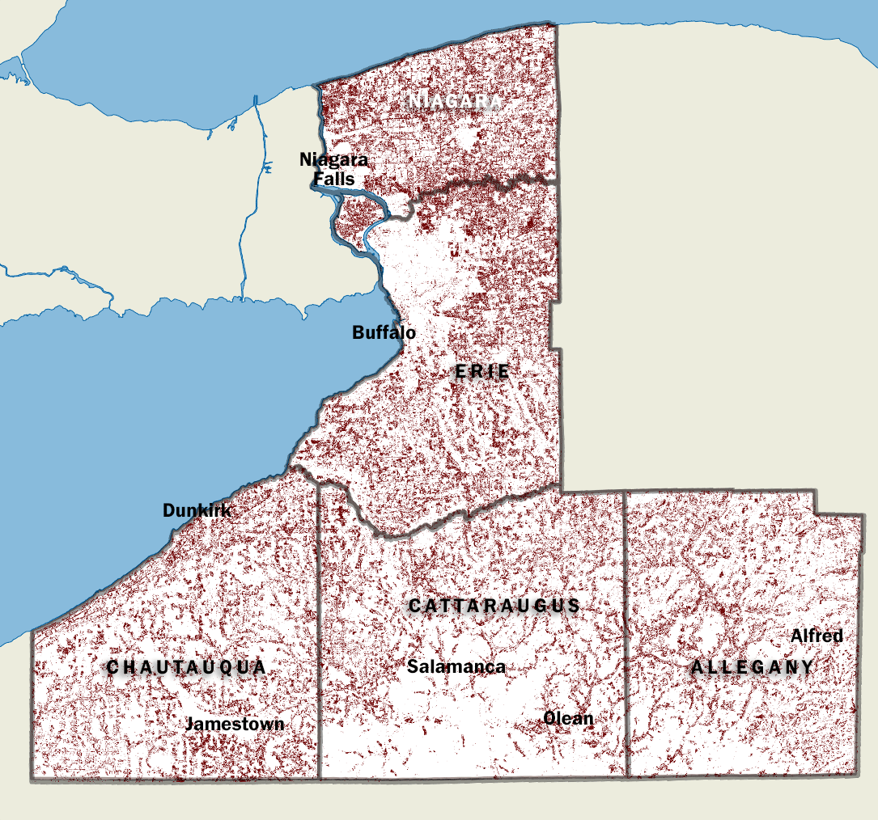
Loss of Agricultural Land in WNY, 1992 to 2011
WNY has been converting (on average), over 41 sq. miles a year
of agricultural land to other uses from 1992 to 2011.
Notes:
Aaron
The Council’s Smart Growth program complements other elements of the region’s broader growth strategy. For example, Smart Growth has aligned itself with the Agriculture Work Group to ensure that the region protects its fertile agricultural land, one our most critical regional assets. And Smart Growth principles also underlie the strategy to improve the tourism experience in Niagara Falls by making its core district vital, walkable and lively, with mixed-use development.

Slide 19
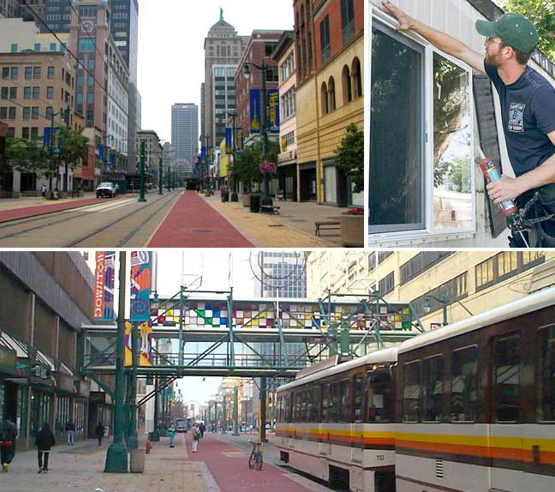
2011 FUNDED PROJECTS
CURRENT PROJECTS
Buffalo Central Business District
Re-establish connections with Main St & connect Central
Business District to waterfront
Construction to begin Spring 2013
Small Business Green Retrofit Initiative
Creating 35+new green jobs for low income individuals
Help up to 60 small businesses and nonprofits access energy efficiency improvements
Notes:
Aaron
The Council’s Smart Growth emphasis is already bearing fruit.
The goal of promoting mixed-use development and connectivity between key assets is also at the core of several projects funded by the REDC in Buffalo. New green infrastructure and streetscape improvements will better connect the city’s financial district with the growing Medical Campus, and after years of dormancy, the return of multi-modal transportation to Main Street will accelerate the revival already underway in the downtown core.

Slide 20
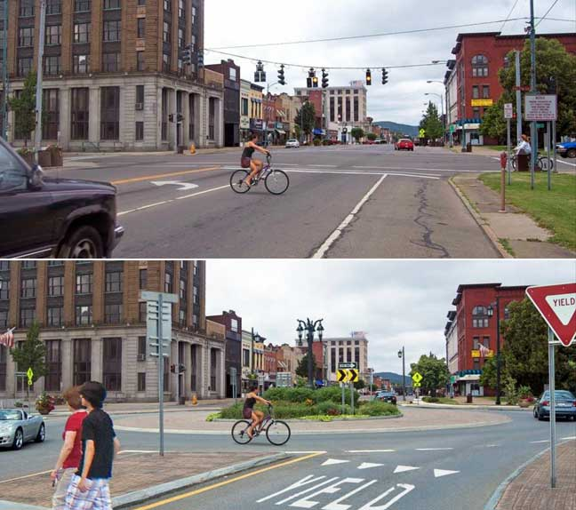
2011 FUNDED PROJECTS
Olean Redevelopment
Redesign of high traffic commercial corridor to enhance safety & walkability as well as improve the flow of traffic
BEFORE
AFTER
Notes:
Aaron
In Olean construction has begun on REDC-funded projects that will promote ground-floor retail and upper-floor residential rehabilitation along the city’s historic Main Street. A related project will improve the streetscape and connectivity between Main Street and two of the city’s largest employers on the edge of downtown.

Slide 21
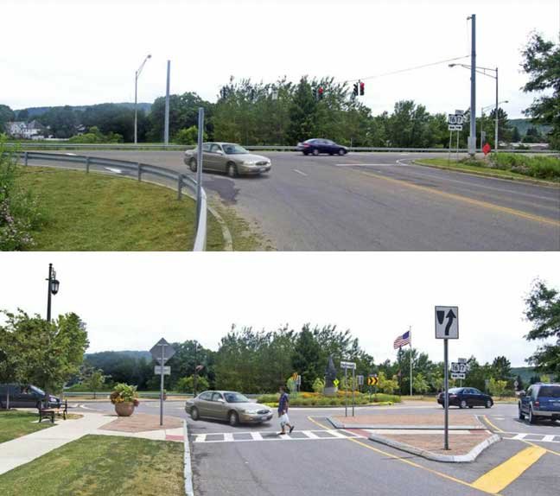
2011 FUNDED PROJECTS
Olean Redevelopment
BEFORE
AFTER
Notes:
Aaron

Slide 22
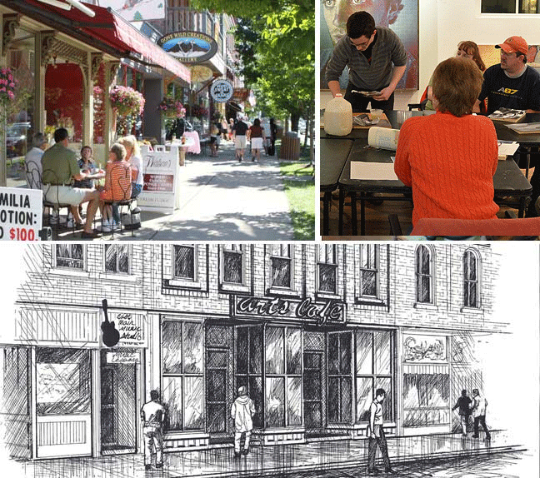
2012 PROPOSED PROJECTS
Western Region Corporation Community Revitalization Program
Matching loan/grant fund for community revitalization to enhance job creation and private investment
Downtown Niagara Falls Stabilization Project
Will attract young professionals to downtown Niagara Falls
Springville redevelopment
Adaptive reuse of historic buildings in the commercial center of the village
Notes:
Aaron
Small villages are also benefitting from the Council’s emphasis on Main Street revival. In Springville, the Council has advanced a development proposal in this year’s CFA that would build on citizen-led efforts to create an arts district at the core of the village. The projects include an Arts café and the restoration of the village’s vibrant community arts organization.
The Smart Growth program advanced by the Council will help to revive historic commercial strips throughout the region, with a new fund created to assist business owners with weatherizing their buildings comprehensively to reduce utility costs and save energy and a revolving loan fund proposed in this year’s CFA round to broaden access to needed capital for small businesses.
The Council’s emphasis on promoting compact, mixed-use, pedestrian-friendly development multiples several goals simultaneously. By restoring our Main Streets and core neighborhoods from Buffalo to Olean and by building walkable, vital and equitable communities, and by reducing infrastructure and maintenance costs in the process, we are positioning the region to grow and compete in the global economy.
TRANSITION TO ADVANCED MANUFACTURING… INTRODUCE SATISH

Slide 23
Manufacturing is an important asset in the Buffalo Niagara’s economy
Despite steady job loss over the last 40 years…
…manufacturing is still the
3rd
largest
employment
sector in
Buffalo Niagara
Notes:
Satish
Our commitment to building a 21st century knowledge-based economy doesn’t mean abandoning the manufacturing base that has played a critical role for Buffalo over the years. Just the opposite—we have a great opportunity to evolve our region’s manufacturing base so that it will be a key contributor to an innovation economy.
While manufacturing has experienced significant job losses in line with national and global trends, is it still the third largest employment sector in WNY. But leveraging this resource to the fullest extent means that our region must adapt to keep pace with evolving needs and opportunities.
Focusing on advanced manufacturing enables us to do exactly that by integrating innovative technologies into the manufacturing of products and processes—especially with our medical devices, precision instruments, advanced materials, and energy storage areas.
Our people are one of the greatest resources. Connecting manufacturers to research and expertise is critical to maintaining a highly-skilled workforce. Research universities provide an essential resource for this sector from highly skilled professionals to access to cutting-edge knowledge produced by university faculty.

Slide 24
Low Productivity
9%
Lower than the US avg.
Slipping Exports
Exports fell from
11.6% to 9.9%
as a percentage of GDP in the last three years
and are below the US avg. of 10.7%
Stagnant Innovation
Only
25%
of surveyed local manufacturers felt their company
improves faster
than its industry
Notes:
Satish
Of many strategic opportunities in the area of advanced manufacturing, Western New York has several clusters of manufacturing strength that give us a competitive advantage.
Ceramics is driven by university research and development and can be leveraged for greater innovation. This is due to an existing infrastructure where regional suppliers are co-located and companies can tap into low-cost hydropower.
The pharmaceutical and medical device clusters are also high-growth sectors in WNY, with 20% more production in these sectors than the U.S. average.
__________________________________________________________________
SKT Notes on Manufacturing clusters:
CERAMICS- Alfred University is well recognized as a leader in ceramics and glass education and research for over 100 years. Collectively, the Ph.D. programs in Ceramics, Glass and Materials Science and Engineering are ranked among the top 50 Materials Science and Engineering programs in the nation and it is recognized among the top 20 specialized research institutions in applied science.
MEDICAL DEVICES- The Center for Innovation in Medicine, a 2011 priority project of the WNYREDC and funded by $4,000,000, is on the Buffalo Niagara Medical Campus. As part of the new Jacobs Institute, this Center will be a full-service resource to promote innovation and entrepreneurship including a cutting-edge, state-of-the-art medical device prototyping facility.
PHARMA- The Center for Genetics and Pharmacology (CGP) located on the campus of Roswell Park Cancer Institute includes a Department of Pharmacology and Therapeutics comprised of 15 major research laboratory units primarily contained within the center.

Slide 25
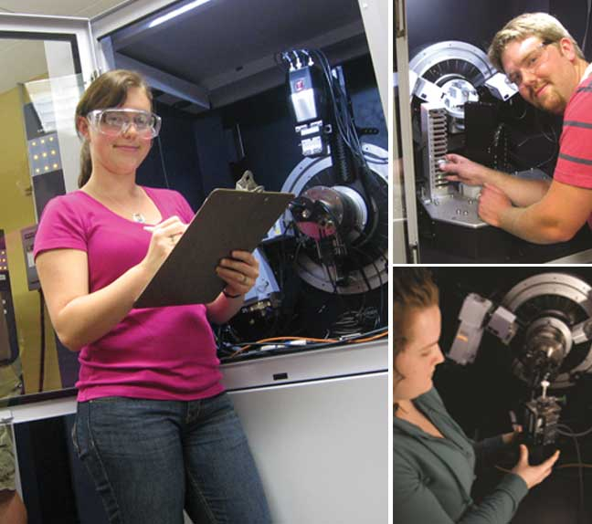
2011 FUNDED PROJECTS
Alfred University High- Temperature Materials Characterization Laboratory
Analyzing high temperature materials is valuable in the development of materials for solar applications and battery storage
Notes:
Satish
Alfred University’s state-of-the-art facilities and resources provide a key asset to the ceramics cluster. Alfred received state funding last year to purchase highly sophisticated laboratory equipment and to renovate facilities for testing applications of high-temperature materials.
This research plays a critical role in finding solutions to the energy and environmental challenges we are facing. Alfred’s lab has already provided critical research support to several major NYS and small fuel cell development companies.
________________________________________________________________
SKT Notes:
Funded areas: This included a wind energy/fluid mechanics lab; a thermal science/solar energy lab; a photovoltaic solar energy lab; an alternative fuels laboratory; and a power conversion and controls laboratory.
The facilities now in place at Alfred University are being widely used by large companies, such as Corning, Delphi, Kodak, and General Electric, as well as smaller companies with a potential for growth, such as Solid Fuel Cell in Rochester, and TAM Ceramics in Niagara Falls. The NY BEST Consortium will make extensive use of the facilities in its battery initiative.

Slide 26
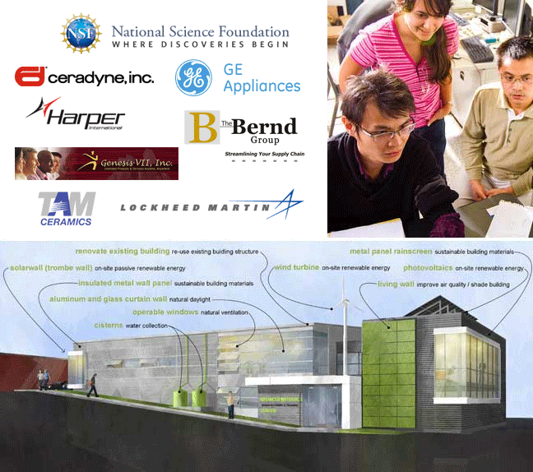
2012 PROPOSED PROJECTS
Alfred University Integrated Manufacturing Center
This partnership with the University at Buffalo will help advance the speed with which new materials and products are brought to market
Ceramic Technology Partners
Joint development project to create a company that makes ceramic products using advanced technologies
University at Buffalo Materials Informatics
Promoting growth in advanced manufacturing, clean technologies, and biomedical devices
Notes:
Satish
With strong research and development and advanced manufacturing infrastructure, WNY is positioned well to accelerate the discovery and commercialization of innovative new materials. This includes synthetic replacements for natural elements that are rapidly growing scarcer. Harnessing this research, the WNY REDC is proposing several investments that will drive new technologies in energy, automotive, clean tech, medicine, military.
____________________________________________________________
SKT Notes on 2012 proposed projects:
Alfred University Integrated Manufacturing Center: Alfred University is proposing to partner with the University at Buffalo to create an Advanced Materials Manufacturing and Training Center to substantially advance the speed with which new materials, and therefore new products and processes, are brought to market. The new facility would give Western New York a unique capability in the area of integrated computational materials science and engineering.
Ceramic Technology Partnership, LLC: Calix Ceramic Solutions, GNP Ceramics, and Ceramic Technology Partnership are proposing a joint development project to create a company which makes ceramic products using three new advanced ceramic manufacturing processes. The expanded businesses will bring to the local area: technology based sustainable growth, support of other area businesses, enhanced availability of necessary resources, and add to the long term growth of ceramics manufacturing and related support operations in the region.
The University at Buffalo's New York State Center of Excellence in Materials Informatics (CoE) will be a driving force for technological breakthroughs and job creation in Western New York by undertaking applied materials research driven by industrial needs. The Center of Excellence’s materials innovations will improve the region’s competitiveness and drive economic growth in three key areas: advanced manufacturing, clean technologies, and biomedical devices. In addition to meeting industry needs, the Center of Excellence will leverage the region’s materials informatics research capacity to drive innovation and commercialization.

Slide 27
Buffalo has an emerging healthcare cluster with a solid foundation
Over
BNMC
260
WNY is home to
Many of the region’s leading life science orgs collocated here
28
Hospitals
Life sciences companies
3,600
Doctors
in the Buffalo Niagara region
20,500
Nurses
16,700
Medical Personnel
12,000
Full-Time
Employees
Notes:
Satish
Buffalo’s healthcare cluster has tremendous potential for revitalizing our region. By leveraging our expanding life sciences industry, WNY will become a world-class destination for health care and life sciences companies.
With $300 million already invested in critical life sciences infrastructure over the past decade, our region is home to more than 260 life sciences companies which include research centers, medical device manufacturers, and biotech companies.
Many of the region’s leading life science organizations making these new discoveries are co-located at Buffalo Niagara Medical Campus, a hub with nine member institutions, including the University at Buffalo.
--
Moreover, the WNY region is well known for major breakthroughs in life sciences and medical ‘firsts.’
That pioneering work continues in WNY, including more than 500 clinical trials each year and $350 million dollars in annual research expenditures at the University at Buffalo.
In fact, the Buffalo-Niagara region ranks 7th nationally in National Institutes of Health funding dollars.
By integrating clinical care, medical education, and research, the region will generate even more innovation and discovery in life sciences.

Slide 28
Notes:
Satish
The hub of that innovation is found on the Buffalo Niagara Medical Campus.
An imperative for our region’s revitalization is to strategically invest in our existing life sciences infrastructure and innovative areas of strength—our medical devices and pharmaceuticals cluster plays a critical role in this regard.
Much of that infrastructure is already in place at the BNMC with 4.5 million square feet of existing clinical, research, and support space and another two million square feet currently or soon-to-be under construction—equaling an investment of $750 million in private and public funding.
This hub of clinical and research innovation already brings more than one million patients and visitors to the medical campus annually. We are projecting that by 2017, nearly 17,000 people will be working on the Buffalo Niagara Medical Campus.

Slide 29
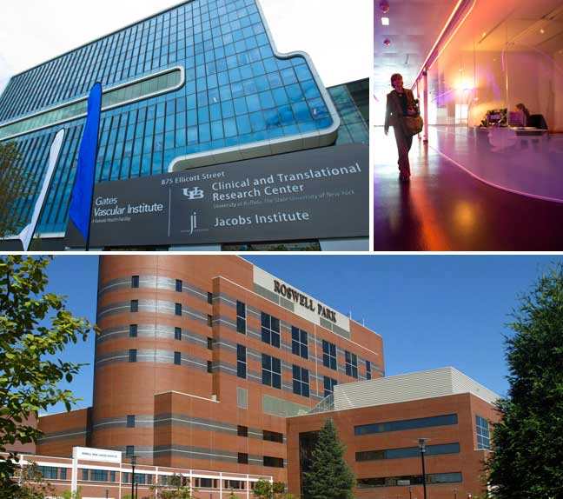
2011 FUNDED PROJECTS
Jacobs Institute Center for Innovation in Medicine
Only center for entrepreneurship in the heart of a clinical facility
WNY Genomics & Health Consortium at Roswell Park
Will create 32 new jobs
Will establish infrastructure for robust approach to personalized medicine
Notes:
Satish
With WNY REDC’s 2011 priority projects: The Center for Innovation in Medicine, Roswell Park Cancer Institute Genome Project, and Hauptman-Woodward Crystallization Laboratory; we are enhancing the research and commercialization capacity of the region’s health and life sciences industries. The result: better health outcomes and more economic development for our region.
_____________________________________________________________
SKT Notes:
These are the three priority projects funded last year in WNY’s health and life sciences industry sector:
Center for Innovation in Medicine will be a center for innovation and entrepreneurship, which will include a cutting-edge, state-of-the-art medical device prototyping facility. It will be the only U.S. center for entrepreneurship in the heart of a clinical facility and will include a fabrication center, machine shop, and clean room, to create new devices and techniques and a training center for physicians to test them.
Roswell Park Cancer Institute Genome Project is building a robust approach to personalized medicine based on detailed definition and study of genetic sequences, the health information data associated with the individuals, genetic sequences and a powerful informatics approach to enable analysis and discovery to inform more personalized medicine.
Hauptman Woodward Crystallization Laboratory is expanding the high throughput crystallization laboratory biotech services at this research institution to expand services and offer competitive and sustainable research. The Hauptman-Woodward Crystallization Laboratory is a successful business, with hundreds of academic clients. EDC funds support the acquisition of a SONICC instrument, which will make it much easier to see crystals, and provide a unique market advantage to attract high-fee, commercial clients.

Slide 30
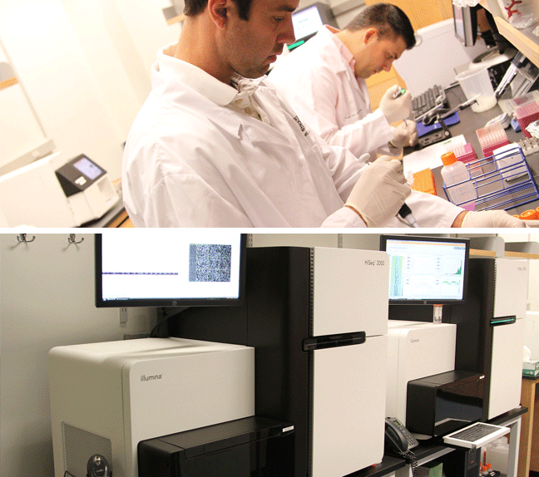
2012 PROPOSED PROJECTS
Personalized Medicine Biorepository
University at Buffalo partnership with Hauptman Woodward and Roswell Park
Aligns with other CFA investments on BNMC
250 jobs created over 5 years
Notes:
Satish
We are at a pivotal moment of opportunity in our region, thanks to historic levels of state investment in our region and its emerging knowledge economy. We can build on that momentum even further by leveraging last year’s state investments with the WNY REDC’s life sciences priority project proposed for 2012.
Specifically, the Personalized Medicine Repository will attract more patients to WNY’s clinical care facilities, drive enriched research collaborations across the globe, and accelerate expansion of WNY’s informatics and diagnostics business in life sciences.
This will accelerate the creation of new companies, expand existing companies, attract new companies to the State. The result: substantial economic growth, including significant job creation in a high-growth sector.
TRANSITION TO TOURISM… INTRODUCE HOWARD…
____________________________________________________________
SKT Notes:
Personalized Medicine Bio-repository: The University at Buffalo, in collaboration with colleagues at Hauptman-Woodward Medical Research Institute and Roswell Park Cancer Institute, proposes the creation of a Deep Image Annotation Enabled Bio-Repository (DIAEB) for Precision Diagnostics to ensure the community will have the best diagnostic resources available to researchers and clinicians. UB’s new Clinical and Translational Research Center—part of a unique public-private research and clinical partnership that is one of only a handful of such facilities of its kind in the nation—will play a leadership role in this partnership.

Slide 31
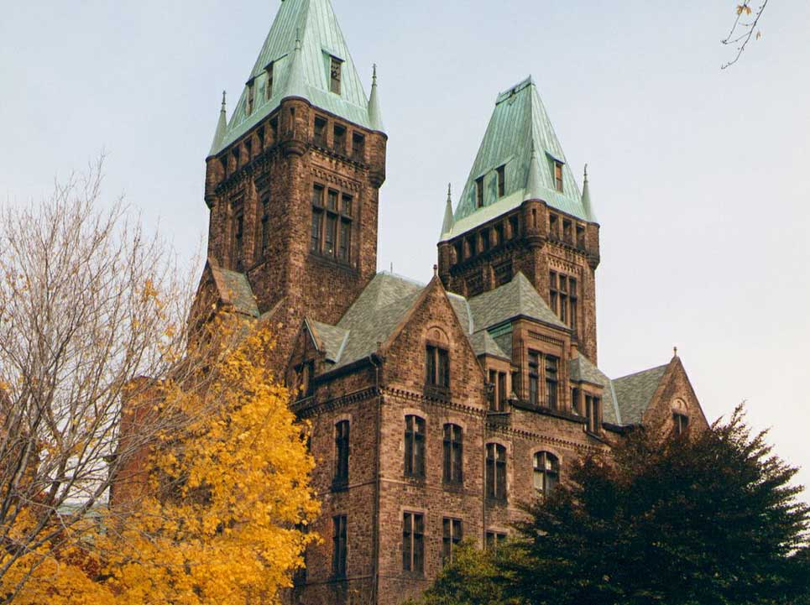
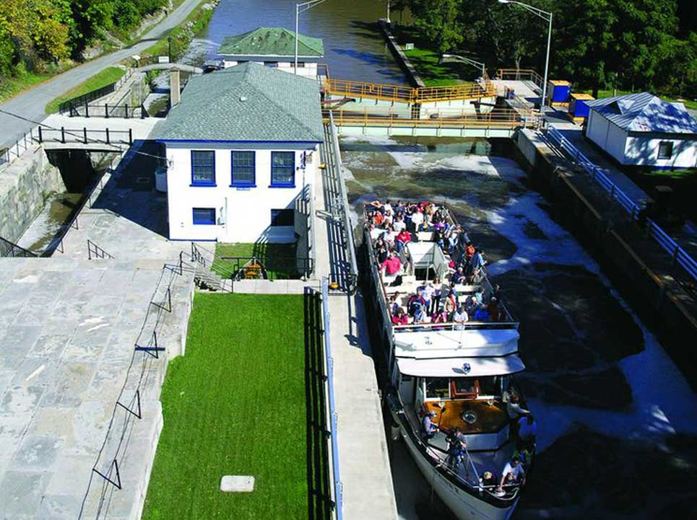
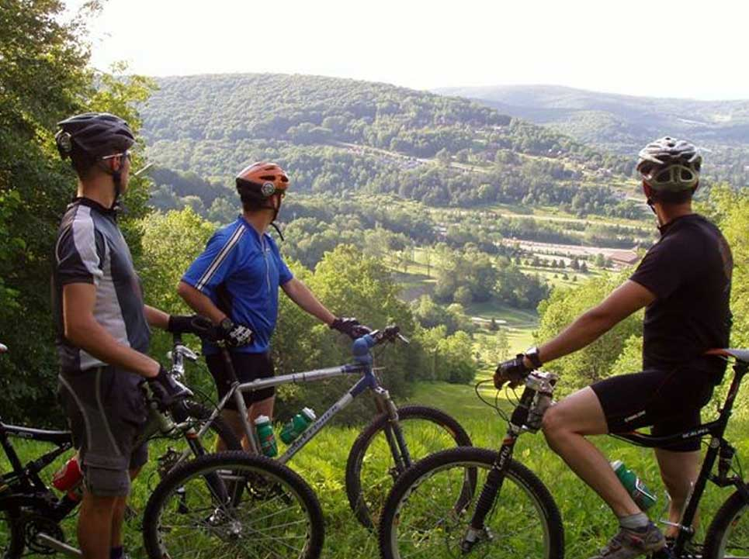
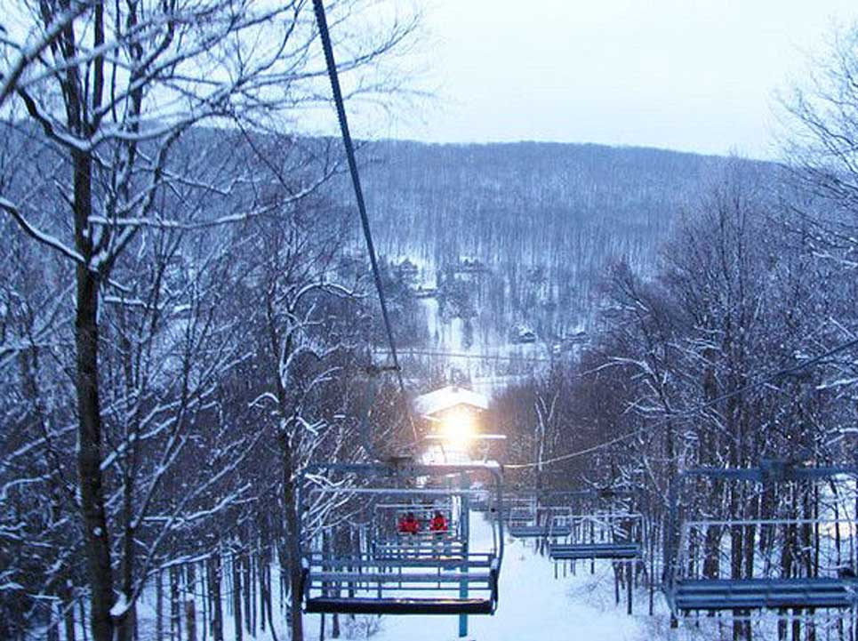
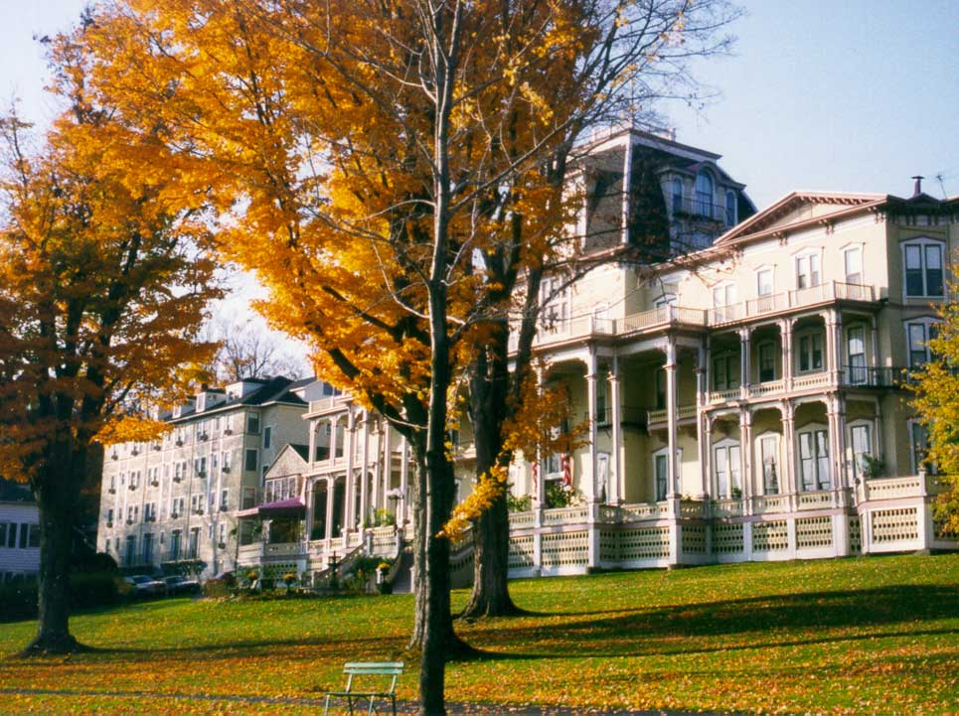

Slide 32
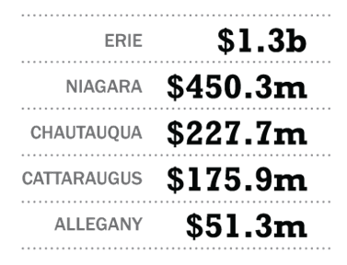
Economic Impact of Visitor Spending in 2009
Tourism spending exceeds $2.2 billion annually
In WNY,
Tourism employed
25,000
people
in 2011
Notes:
Howard

Slide 33
Niagara Falls Park has strong overall attendance and potential to grow overnight stays
Total Annual Visitors (Millions)
Total Annual Overnight Visitors (Percent)
Buffalo Niagara
8.0
21
Grand Canyon NP
4.4
28
Yosemite NP
3.9
44
Yellowstone NP
3.6
36
Rocky Mountain NP
3.6
5
Notes:
Howard

Slide 34
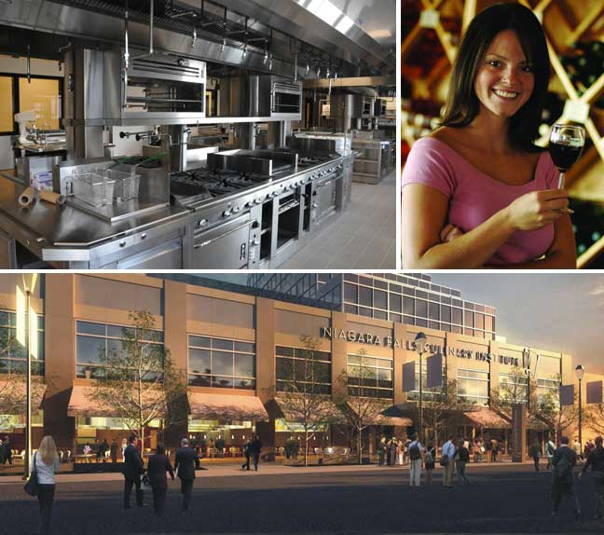
2011 FUNDED PROJECTS
Niagara County Community College Culinary Institute
Will house 1,000 students, plus faculty & staff
Will bring 200,000+ extended visits to Niagara Falls each year
Niagara Wine Trail
In 2010, the 16 wineries on the Trail received 30,000+ visitors per winery
155 signs will be installed along the trail
Notes:
Howard

Slide 35
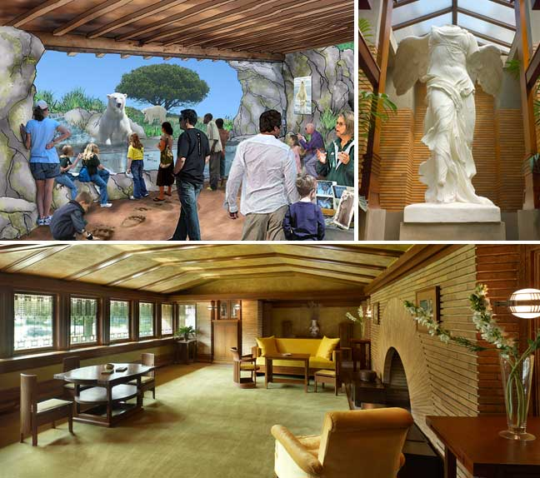
2012 PROPOSED PROJECTS
Allegany State Park
Increase tourism by adding full service cottages, world class ropes course and zip line attraction
Darwin Martin House Interior Restoration
Final major phase of 15 years of restoration activity
Fully restored complex will attract 50,000-80,000 visitors annually
Buffalo Zoo Arctic Edge Exhibit
450,000 visitors annually
Notes:
Howard

Slide 36
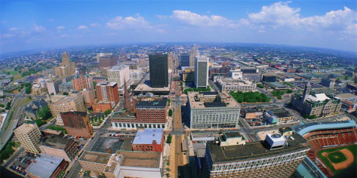
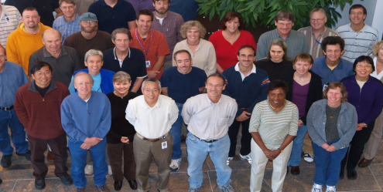
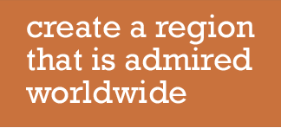
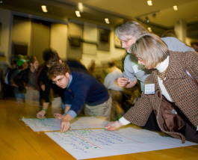
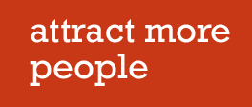
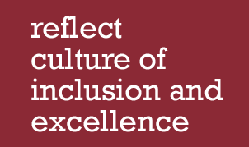
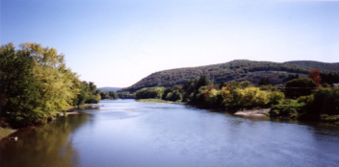
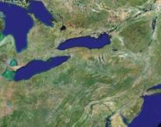
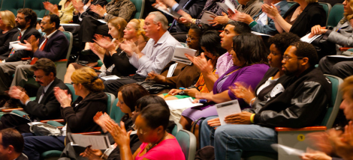
Notes:
Howard

