Slide 1
Workforce diversity: What Works?
John Goldstein
Coalitions, Campaigns and Community Benefits
May 25, 2016
Sponsored by Investigative Post

Slide 2
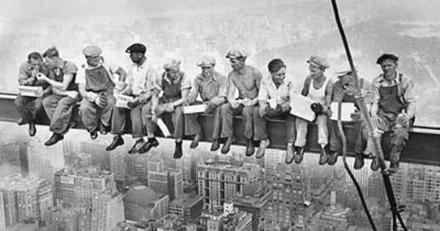
Workforce diversity: What Works?

Slide 3
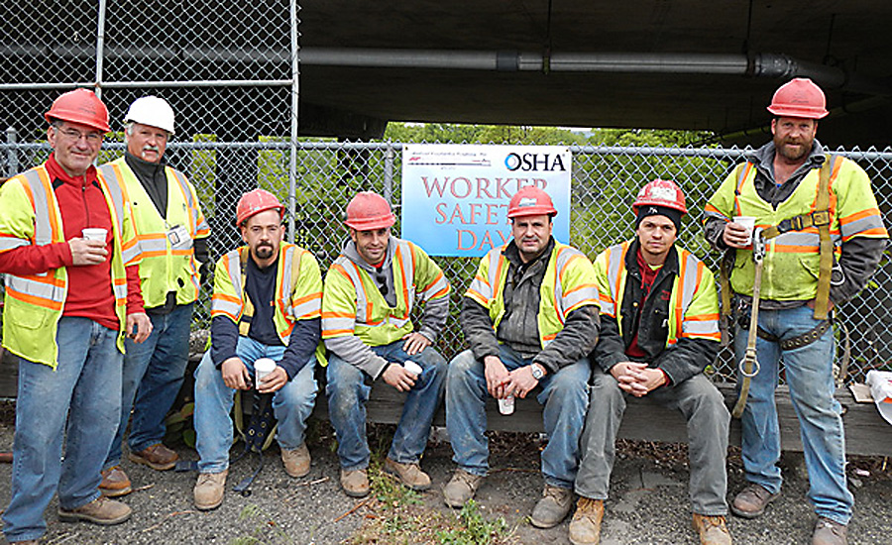
Workforce diversity: What Works?
“No one on that construction site looks like me…”

Slide 4
Workforce diversity: What Works?
Organize Supporters
Create Demand
Develop Pipeline
Address Barriers
Monitor and Enforce

Slide 5
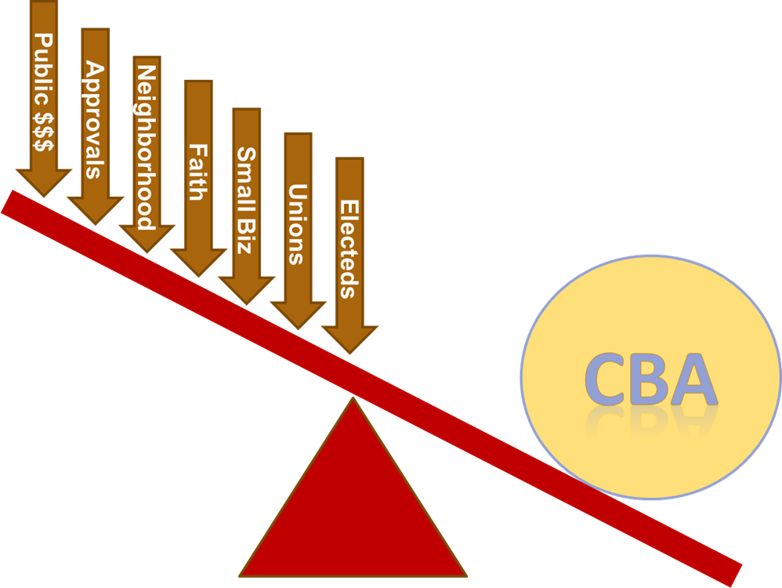
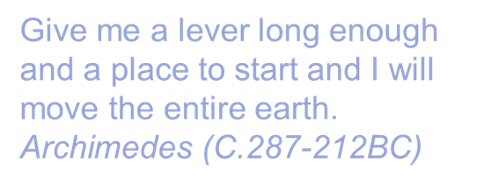
Workforce diversity: What Works?
Organize Supporters
Local Hire
Notes:
Coalition of the Eager. Some usual suspects--- civil rights organizations; faith based networks; NAACP; Urban League; elected leaders
Some unusual:
Baltimore- business community in response to Black Lives Matter
Minority Chamber of Commerce
Contractors
Construction Unions

Slide 6
Workforce diversity: What Works?
Create Demand
Identify Standards That Will Work
Establish Target Population(s)
% of Hours Worked
Maximize Apprenticeship Ratios
Measureable and Enforceable
Agreement to Attach Standards to:
Condition of Public Subsidies
  Policy or Ordinance (City, County, IDA)
  Part of RFP for a Project
  Development Agreement
Private Agreement with Developer
Project Labor Agreement

Slide 7
Workforce diversity: What Works?
Develop Pipeline
Work with Stakeholders: Contractors, Unions, Technical College
Identify Funders: Contractors, Workforce Investment Board, Private Foundations
Identify Minimum Standards
Pre-Apprenticeship; Job Readiness
Recruitment by Community Groups and Public Agencies
Need a champion leading this work

Slide 8
Workforce diversity: What Works?
Address Barriers
    Previous Incarceration
    Drug Testing
    Drivers License and Transportation
    Immediate Need for Income
    Real Jobs at the End of Training
    Mentorship and Support

Slide 9
Workforce diversity: What Works?
Monitor and Enforce
Periodic Reporting Requirement
Comprehensive Tracking System
Certified Payrolls
Independent Compliance Officer
Community Oversite
Sanctions for Non-Compliance

Slide 10
Workforce diversity: What Works?
Milwaukee
1990s Residence Preference Program
Required 25% residents on DPW contracts
2004 Park East Redevelopment Compact
Downtown redevelopment
Prevailing Wage, local hire, local contracting, affordable housing
Now applies to new Bucks arena
2009 Milwaukee Opportunities for Restoring Employment (MORE) extends standards to private projects seeking financial assistance from taxpayers:
Prevailing wage requirement
40% of work performed by unemployed or underemployed workers
Increased apprenticeship opportunities for residents of Milwaukee’s poorest neighborhoods
Bidding advantages for businesses located in Milwaukee

Slide 11
Workforce diversity: What Works?
Oakland Army Base
In 2012, the Revive Oakland coalition won job standards for the $800 million redevelopment of the Oakland Army Base into a modern goods movement and warehousing development:
Living wage
50% local hire, 25% hiring disadvantaged workers
West Oakland job and training center
Long-term community oversight board to oversee compliance
All new union apprenticeships reserved for Oakland residents
No pre-screening of job applicants for prior criminal records
Project labor agreement ensures safe conditions and quality jobs
Limits on use of temp agencies

Slide 12
Workforce diversity: What Works?
Kingsbridge Armory (Bronx)
In 2013, the Kingsbridge Armory Redevelopment Alliance reached a groundbreaking CBA for development of the nation’s largest ice sports center:
Living wage for all workers within the project;
At least 25% of construction employees be targeted workers;
At least 51% of non-construction workers are local with first priority to underemployed residents of immediate neighborhood;
$8,000,000 contribution to a coalition-controlled fund for community needs;
Incentives for local businesses to employ local workers;
Local contracting, M/WBE utilization, and local procurement requirements;
LEED certified green building standards;
Priority community access to the project’s athletic facilities;
Community-based oversight and enforcement of CBA commitments.

Slide 13
Workforce diversity: What Works?
Los Angeles: Construction Careers Policies
Since 2001 LA has implemented six Community Workforce Agreements covering over $12.3 Billion in construction value and over 56,700 construction jobs. Provisions include:
30-40% of new construction jobs filled by residents of neighborhoods adjacent to the project.
10–15% of construction work hours performed by at-risk workers, including workers from poor households and workers with a history of incarceration or receipt of public assistance.

Slide 14
Workforce diversity: What Works?
We Can Help
John Goldstein
jgoldstein@cocacom.org
414-530-7081

Slide 15
Workforce diversity: What Works?

Slide 16
Workforce diversity: What Works?

